Slide 1


Slide 2

Problem Statement
Varinda store wants to create an annual sales report for 2022.So, that Vrinda can understand their customers & grow more sales in 2023.

Slide 3


Primary Analysis
1.Primary KPI’s of total sales, Order count & Avg Order value
2.Order Vs Sales by 2022 Months (Time Trends
3. Analysis of Top 5 states by Sales (Customer insights)
4. Orders by age group Vs gender(Adult women are the backbone of sales, teenagers (esp. women) are the rising market

Slide 4
Primary Analysis
5. Overall Comparison of Sales between men & women(Women are the primary customer base across all age groups
6. Operational insights of order status
7. Sales analysis of different channels
8. Track top-selling products (kurta, set, top, western dress).

Slide 5
Secondary Analysis
1. Target Campaigns: Example — if most buyers are women aged 25–40, create campaigns specifically for them.
2. Recommend products based on past purchases & categories.
3. Spend more on ads/partnerships with top-performing channels.
4. Identify products often bought together (e.g., kurta + set).

Slide 6
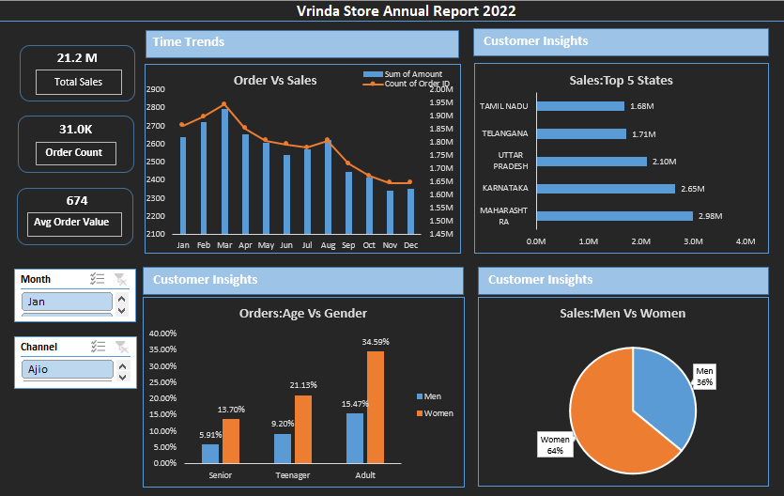

Slide 7
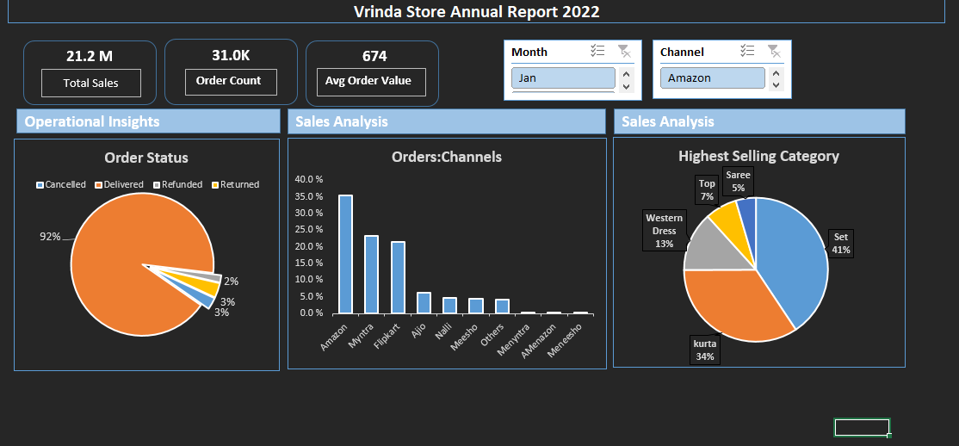
Report

Slide 8


Thank you
https://www.linkedin.com/in/humnashafiquedataanalyst/

